Slide 1

人工智能核心能力培养 — Lecture 09 Convolutional Neural Network The Kernel Ability For Artificial Intelligence
高民权

Slide 2


Review
序列问题 Sequence Problem
循环神经网络 Recurrent Neural Network
长短记忆模 LongShortTermMemory
GRU: GatedRecurrentUnit
RNN的应用 Applications of RNNs

Slide 3
TOday
卷积神经网络原理 CNN
基于深度血学习的计算机视觉的核心原理
ResNet等现代CNN网络架构

Slide 4
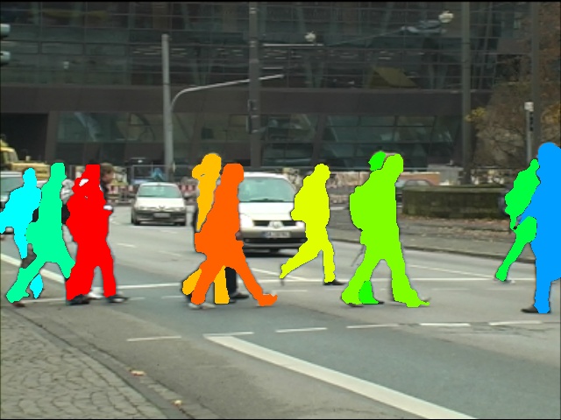

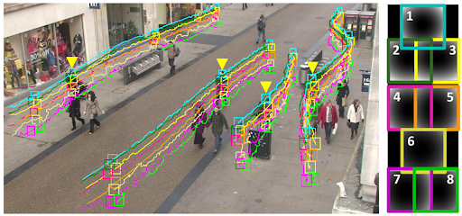
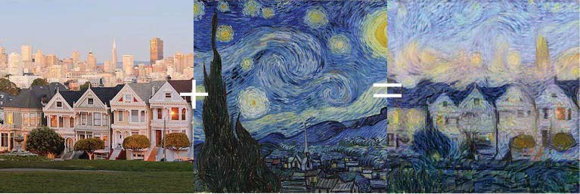

Slide 5
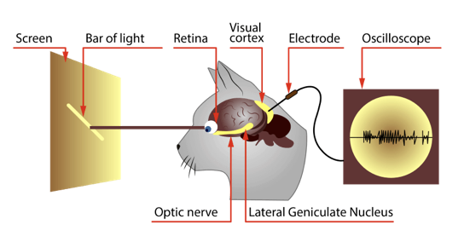

Slide 6
The function of
filter_ = np.array([
[1, 0, -1],
[1, 0, -1],
[1, 0, -1]
])

Slide 7
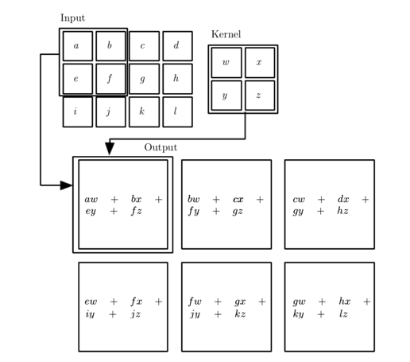

Slide 8
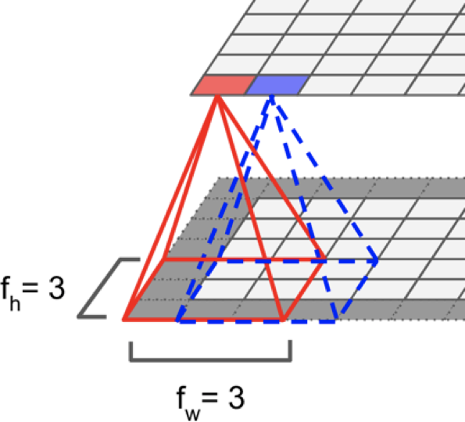
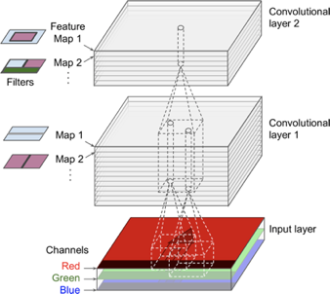

Slide 9
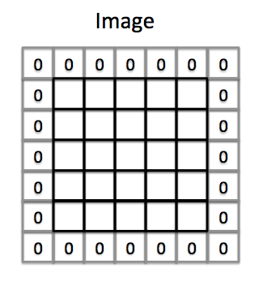
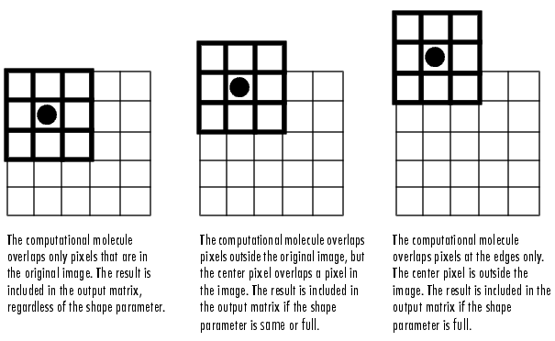

Slide 10
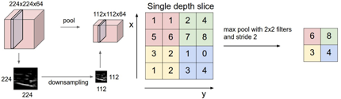
Pooling layer

Slide 11
Important!
Parameters Sharing and Location Invariant

Slide 12
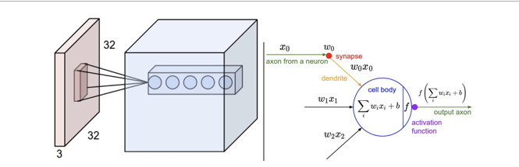
Fully connected layer

Slide 13
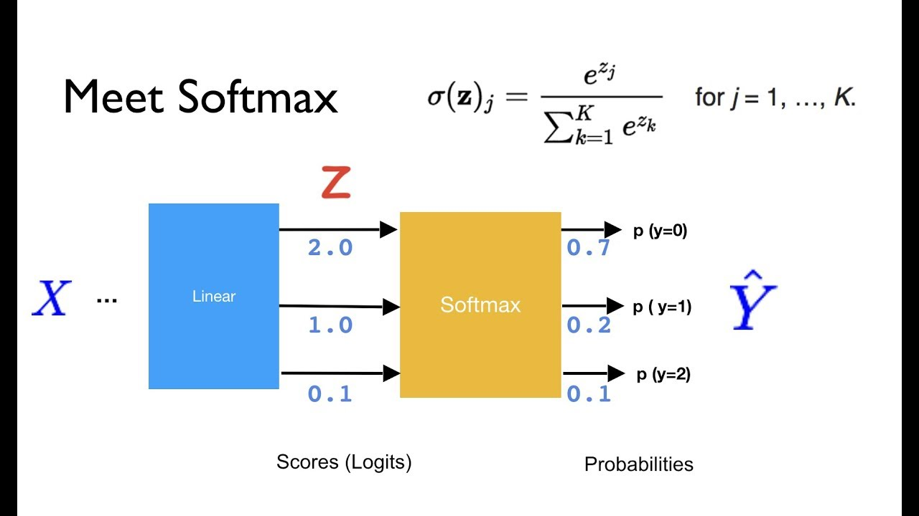
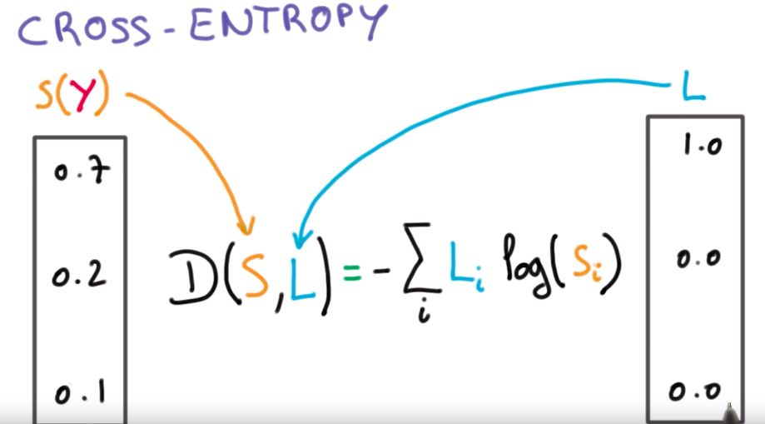
Cross-entropy and softmax

Slide 14
New
Data
特征提取
Feature extractor
Framework 机器学习的通用框架
x
1
3
2
Observed
Data
$$θ$$
Loss function
特征提取
Feature extractor
向量
vector
学习
Learning
f
Acc / precision
X1 = [0.1, 0.21, 0.33, 0.98]
Y1 = [0, 0, 1]
4
y
X2 = [0.23, 0.98, 0.33, 0.98]
Y2 = 0, 1, 0]
Gradient Descent
X3 = [0.143, 0.87 0.1 0.98]
Y3 = [1, 0, 0]
What’s the difference of Supervised Learning and Unsupervised Learning?

Slide 15

Programming – lecture-09
How can computer recognize images?

Slide 16
summary
1. What’s the convolutional neural networks?
2. The applications of CNNs
3. Filters, Padding, Strides, Channel
4. Parameters Sharing and Location Invariance

Slide 17

Le-Net 5
Yann LeCun, 1998
Conv
5 * 5, s = 1
Pooling
F = 2,S = 2
Conv
5 * 5, s = 1
Pooling
F = 2, S = 2
32 * 32 * 1
28 * 28 * 6
14 * 14 * 6
10 * 10 * 6
5 * 5 * 6
120
84
10
Tanh, Sigmoid As Activation Function

Slide 18
Alex-net
Relu As activation Functions
Training On GPU
Conv
11 * 11
Same Padding
Conv
11 * 11
S = 4
Max-pooling
3 * 3
S = 2
Alex Krizhevsky, Hinton, 2012
Max-pooling
3 * 3
S = 2
55 * 55 * 96
27* 27 * 96
27* 27 * 256
23 * 13 * 256
Conv
3 * 3, same
Conv
3 * 3, same
Conv
3 * 3, same
Max-pooling
227 * 227 * 3
10
13 * 13 * 384
13 * 13 * 384
13 * 13 * 256
6 * 6 * 256
9216
4096
4096

Slide 19
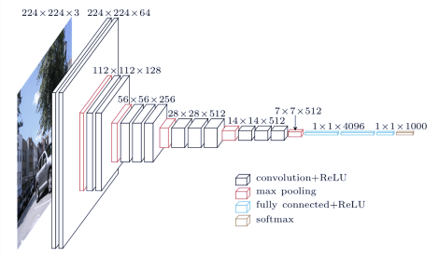
VGG-Net
Conv = 3 * 3, s = 1, same padding
Max-pooling = 2 * 2, s = 2
224 * 224 * 3

Slide 20
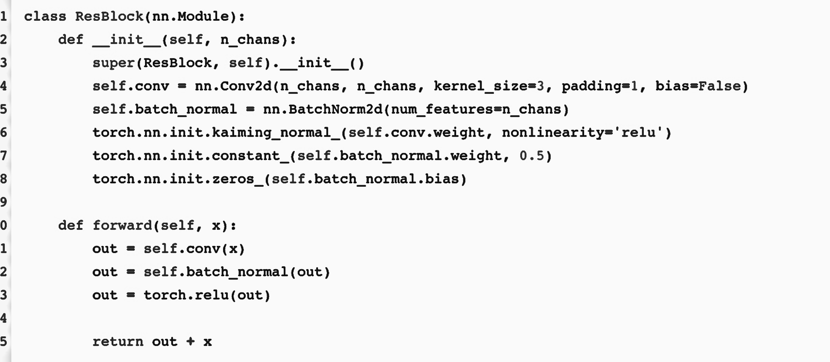
Res-net
Deep Networks are very difficult to train because gradient vanishing and exploding problems.
Residual Blocks

Slide 21
Res-Net
Implement using Pytroch

Slide 22
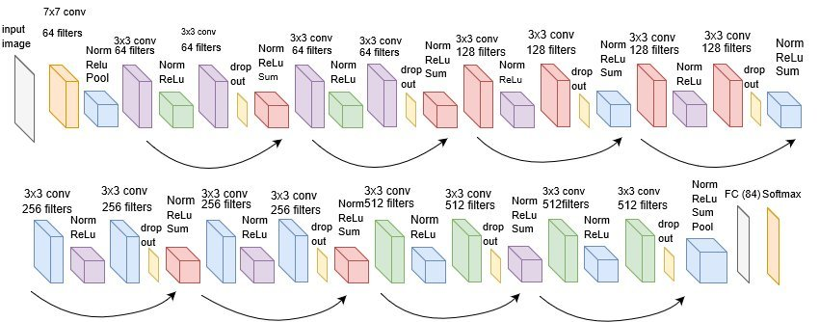
RES-Net: Very Deep Neural Network

Slide 23
Inception (Google Net)
8 * 8 * 3
GoogLeNet, 1 * 1 convolutional
1 | -2 | 7 | -1 | 7
2 | 3 | 8 | 3 | 6
3 | 4 | 9 | 4 | 4
4 | 5 | 8 | 5 | 33
5 | 6 | 5 | 6 | 2
5 | 0 | 35 | 0 | 35
2 | 3 | 8 | 3 | 6
3 | 4 | 9 | 4 | 4
4 | 5 | 8 | 5 | 33
5 | 6 | 5 | 6 | 2
5
Relu
1 * 1 *?(A)
1 * 1
6 * 6
6 * 6
?B * ?C * ?D

Slide 24
Inception (Google Net)
GoogLeNet, 1 * 1 convolutional
When you design a ConvNet, you want to choose different conv size, 3 * 3.. 5 * 5.. 7 * 7..
Inception said: I need them all ☺
1 * 1
1 * 1
1 * 1
28 * 28 * 64
1 * 1
1 * 1
64
3* 3
With padding
3* 3
With padding
3* 3
With padding
3* 3
With padding
3* 3
With padding
28 * 28 * 128
128
5 * 5
With padding
5 * 5
With padding
5 * 5
With padding
5 * 5
With padding
5 * 5
With padding
28 * 28 * 32
28 * 28 * 3
32
Max-Pooling
With padding
Max-Pooling
With padding
Max-Pooling
With padding
Max-Pooling
With padding
Max-Pooling
With padding
28 * 28 * 32
28 * 28 * （64 +128+32+32）
32

Slide 25
Bottleneck network
5 * 5
With padding
5 * 5
With padding
5 * 5
With padding
5 * 5
With padding
5 * 5
With padding
28 * 28 * 16
5 * 5 *16
28 * 28 * 32
28 * 28 * 32
1 * 1 * 3
1 * 1 * 3
1 * 1 * 256
16 filters
32 filters
28 * 28 * （256）
Computation Consume
5 * 5 * 256 * 32
28 * 28
= 160Million
Computation Consume
1*1*256*16
28 * 28
5*5*16*32
28 * 28
parameters
window size
13 Million

Slide 26
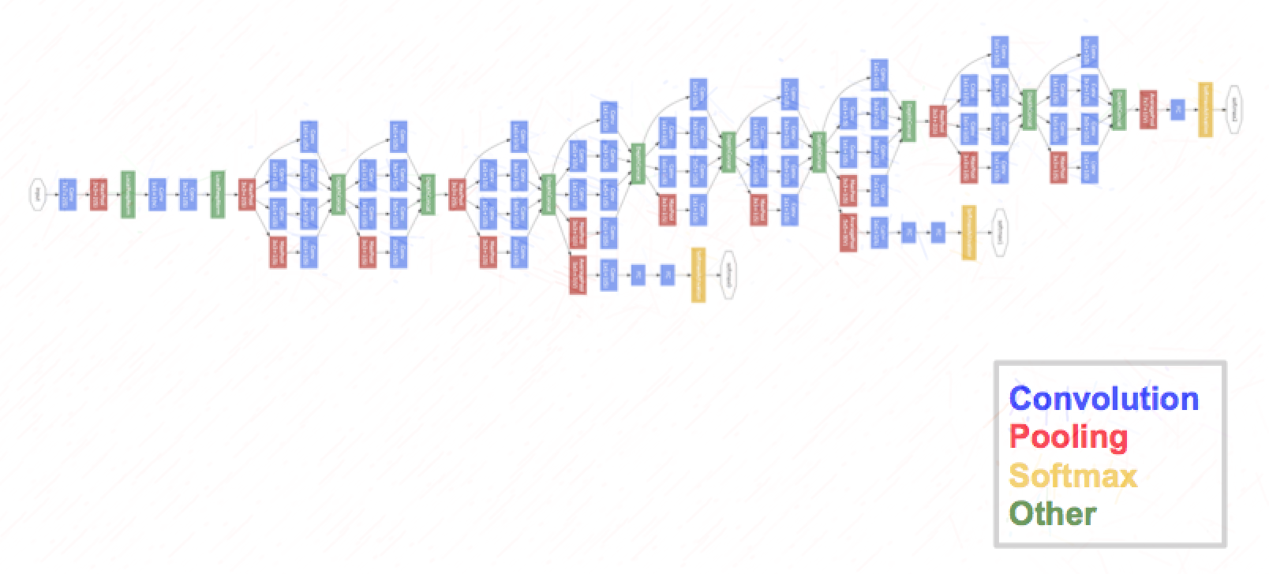
Inception network
1 * 1
3 * 3
1 * 1
1 * 1
5 * 5
28 * 28 * （256）
28 * 28 * （256）
Max pooling
1 * 1

Slide 27
Transfer Learning
The Network became more and more difficult ..

